Slide 1
Unit 1
Lecture 4
Control statements, Arrays in java, Basics of objects and classes in java, Visibility modifiers, Methods, Constructors, Method overloading, Static members, Use of this reference.

Slide 2
In Java, arrays are fundamental data structures used to store a fixed-size, sequential collection of elements of the same data type. They provide an efficient way to organize and access multiple values under a single variable name.

Slide 3
Key Characteristics of Java Arrays:
Homogeneous: All elements within an array must be of the same data type (e.g., int, String, Object).
Fixed Size: The length of an array is determined at the time of its creation and cannot be changed afterward.
Zero-Based Indexing: Elements are accessed using a numerical index, starting from 0 for the first element.
Objects: Arrays in Java are objects themselves, implicitly inheriting from java.lang.Object. This means they have methods like toString(), equals(), and a length property to get the number of elements.

Slide 4
Declaring and Initializing Arrays:
Arrays can be declared and initialized in several ways: Declaration and Allocation.
dataType[] arrayName = new dataType[size];
Example: int[] numbers = new int[5]; (creates an array numbers that can hold 5 integers) Declaration and Initialization (with values).
dataType[] arrayName = {value1, value2, value3, ...};
Example: String[] cars = {"Volvo", "BMW", "Ford"};

Slide 5
Accessing and Modifying Array Elements:
Elements are accessed and modified using their index within square brackets:
Accessing: arrayName[index] (e.g., int firstElement = numbers[0];)
Modifying: arrayName[index] = newValue; (e.g., cars[0] = "Opel";)
Array Length:
The length property provides the number of elements in an array:
Java
int arrayLength = arrayName.length;
Example: System.out.println(cars.length); (outputs 3 for the cars array above)

Slide 6
Multi-Dimensional Arrays:
Java also supports multi-dimensional arrays, which are essentially arrays of arrays. For example, a two-dimensional array represents a table-like structure with rows and columns.
Java
int[][] matrix = {{1, 2}, {3, 4}};

Slide 7
Arrays in Java
Key Points:
Fixed-size data structure
Syntax: int[] numbers = new int[5];
Access via index: numbers[0] = 10;
Example:
String[] fruits = {"Apple", "Banana", "Cherry"}; System.out.println(fruits[1]); // Banana

Slide 8
class Student { public int roll_no; public String name; Student(int roll_no, String name){ this.roll_no = roll_no; this.name = name; }} public class Aoa{ public static void main(String[] args){ // declares an Array of Student Student [] arr; // allocating memory for 5 objects of type Student. arr = new Student[5]; | // initialize the elements of the array arr[0] = new Student(1, "aman"); arr[1] = new Student(2, "vaibhav"); arr[2] = new Student(3, "shikar"); arr[3] = new Student(4, "dharmesh"); arr[4] = new Student(5, "mohit"); // accessing the elements of the specified array for (int i = 0; i < arr.length; i++) System.out.println("Element at " + i + " : { " + arr[i].roll_no + " " + arr[i].name+" }"); }}
Notes:
Arrays of Objects in Java
An array of objects is created like an array of primitive-type data items
Example: Here we are taking a student class and creating an array of Student with five Student objects stored in the array. The Student objects have to be instantiated using the constructor of the Student class and their references should be assigned to the array elements.

Slide 9
Basics of objects and classes in java, Visibility modifiers

Slide 10
Objects and classes are fundamental concepts in Java. A class serves as a blueprint for creating objects, which are instances of that class. Classes A class defines properties (attributes) and behaviors (methods) that its objects will have. Syntax example: public class Car {String color; void drive() {System.out.println("Driving");}} Objects An object is created from a class and represents a specific instance with its own state. Syntax example: Car myCar = new Car(); myCar.color = "Red"; myCar.drive();

Slide 11
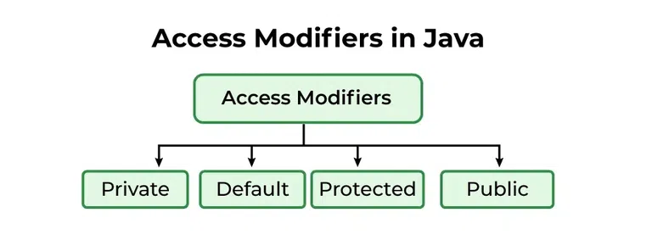
Visibility Modifiers Visibility modifiers control access to classes, methods, and variables. The main types are: public: Accessible from any other class. private: Accessible only within the same class. protected: Accessible within the same package and subclasses. default (no modifier): Accessible only within the same package. Understanding these concepts is crucial for effective object-oriented programming in Java.

Slide 12
Visibility Modifiers Visibility modifiers control access to classes, methods, and variables. The main types are: public: Accessible from any other class. private: Accessible only within the same class. protected: Accessible within the same package and subclasses. default (no modifier): Accessible only within the same package. Understanding these concepts is crucial for effective object-oriented programming in Java.

Slide 13
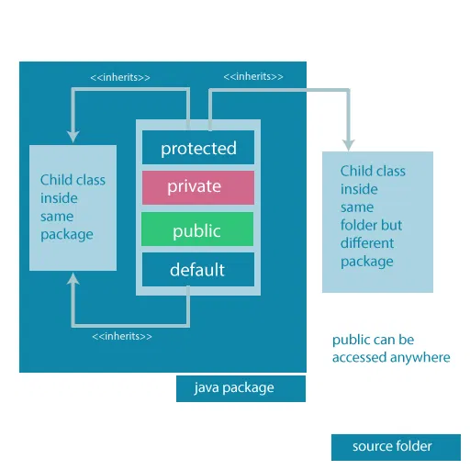

Slide 14
default
package defaultPackage;
class Demo{
void message(){
System.out.println("This is a message");
}
}

Slide 15
public class
// Animal.java file
// public class
public class Animal { // public variable
public int legCount;
// public method
public void display() {
System.out.println("I am an animal.");
System.out.println("I have " + legCount + " legs."); }}
// Main.java
public class Main {
public static void main( String[] args ) {
// accessing the public class
Animal animal = new Animal();
// accessing the public variable
animal.legCount = 4;
// accessing the public method
animal.display();}}

Slide 16
private variable
class Data
{
// private variable
private String name;}
public class Main
{ public static void main(String[] main)
{
// create an object of Data
Data d = new Data();
// access private variable and field from another class d.name = “me"; }}

Slide 17
protected method
class Animal {
// protected method
protected void display() {
System.out.println("I am an animal");
}
}
class Dog extends Animal {
public static void main(String[] args) {
// create an object of Dog class
Dog dog = new Dog();
// access protected method
dog.display();
}
}

